Slide 1


Introduction to Deep Learning with
Sebastian Raschka
PyData Ann Arbor 2017 • August 24, 2016

Slide 2
Slides
Speaker Deck:
https://speakerdeck.com/rasbt/introduction-to-deep-learning-with-tensorflow-at-pydata-ann-arbor
Code snippets
GitHub:
https://github.com/rasbt/pydata-annarbor2017-dl-tutorial

Slide 3
https://static.googleusercontent.com/media/research.google.com/en//pubs/archive/45166.pdf

Slide 4
Tensors?
https://sebastianraschka.com/pdf/books/dlb/appendix_g_tensorflow.pdf

Slide 5
Installing TensorFlow
pip install tensorflow
pip install tensorflow-gpu
https://www.tensorflow.org/install/

Slide 6
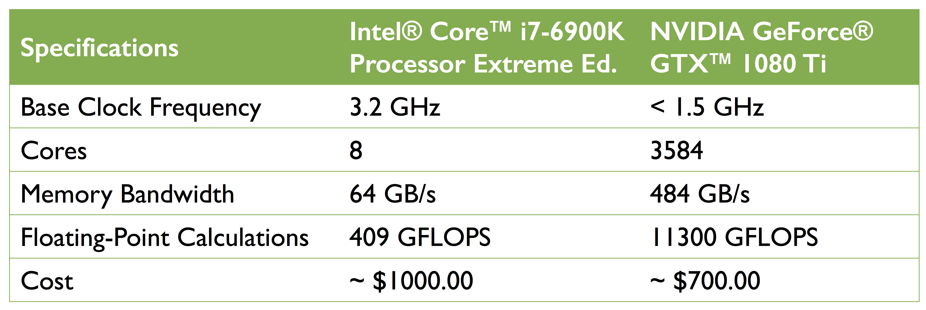
pip install tensorflow
pip install tensorflow-gpu
Setup help:
https://www.tensorflow.org/install/
https://sebastianraschka.com/pdf/books/dlb/appendix_h_cloud-computing.pdf

Slide 7
Vectorization
X = np.random.random((num_train_examples, num_features))
W = np.random.random((num_features, num_hidden))
x
=

Slide 8
logits = np.zeros([num_train_examples, num_hidden])
for i, row in enumerate(X): # row = training_example
for j, col in enumerate(W.T): # col = features
vector_dot_product = 0
for a, b in zip(row, col):
vector_dot_product += a*b
logits[i, j] = vector_dot_product
np.allclose(logits, np.dot(X, W))

Slide 9
https://static.googleusercontent.com/media/research.google.com/en//pubs/archive/45166.pdf

Slide 10
Computation Graphs
a(x, w, b) = relu(w*x + b)
bias term
(“threshold”)
activation function
weight parameter
training example
with 1 input feature

Slide 11
REctified Linear Unit
import matplotlib.pyplot as plt
import numpy as np
def relu(x):
# max(0, x)
return x * (x > 0)
x = np.arange(-10, 10)
plt.plot(x, relu(x))

Slide 12
Computation Graphs
a(x, w, b) = relu(w*x + b)
u
v

Slide 13
Computation Graphs
a(x, w, b) = relu(w*x + b)
u
v
b
+
v = u+b
a = relu(v)
x
*
u = wx
w

Slide 14
Computation Graphs
import tensorflow as tf
g = tf.Graph()
with g.as_default() as g:
x = tf.placeholder(dtype=tf.float32, shape=None, name='x')
w = tf.Variable(initial_value=2, dtype=tf.float32, name='w')
b = tf.Variable(initial_value=1, dtype=tf.float32, name='b')
u = x * w
v = u + b
a = tf.nn.relu(v)
init_op = tf.global_variables_initializer()
print(x, w, b, u, v, a)
a(x, w, b) = relu(w*x + b)
u
v

Slide 15
Computation Graphs
import tensorflow as tf
g = tf.Graph()
with g.as_default() as g:
x = tf.placeholder(dtype=tf.float32, shape=None, name='x')
w = tf.Variable(initial_value=2, dtype=tf.float32, name='w')
b = tf.Variable(initial_value=1, dtype=tf.float32, name='b')
u = x * w
v = u + b
a = tf.nn.relu(v)
print(x, w, b, u, v, a)
Tensor("x:0", dtype=float32) <tf.Variable 'w:0' shape=() dtype=float32_ref> <tf.Variable 'b:0' shape=() dtype=float32_ref> Tensor("mul:0", dtype=float32) Tensor("add:0", dtype=float32) Tensor("Relu:0", dtype=float32)

Slide 16
Computation Graphs
b=1
+
v = u+b
a = relu(v)
x
*
u = wx
w=2
with tf.Session(graph=g) as sess:
sess.run(init_op)
b_res = sess.run(’b:0')
print(b_res)
1.0

Slide 17
TensorBoard
with tf.Session(graph=g) as sess:
sess.run(init_op)
file_writer = tf.summary.FileWriter(logdir='logs/graph-1', graph=g)
In your terminal
$ pip install tensorboard
$ tensorboard --logdir logs/graph-1

Slide 18
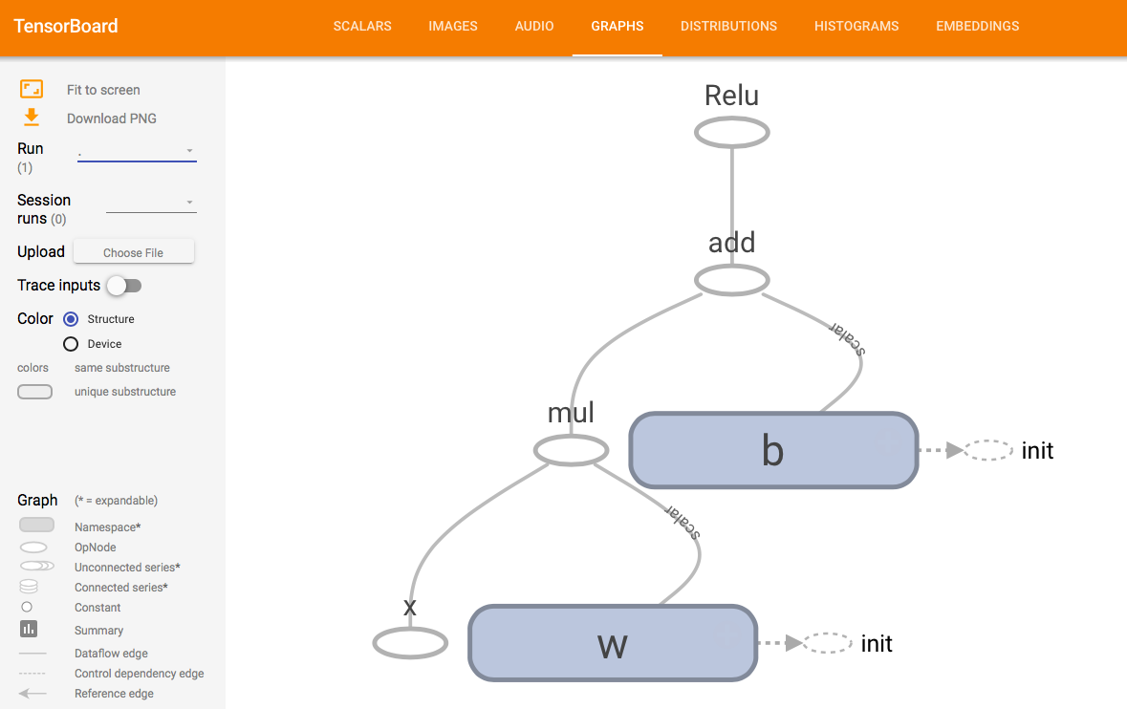

Slide 19
Computation Graphs
b=1
+
v = u+b
a = relu(v)
3.0
x
*
u = wx
w=2
with tf.Session(graph=g) as sess:
sess.run(tf.global_variables_initializer())
u_res, v_res, a_res = sess.run([u, v, a], feed_dict={'x:0': 3.})
print(u_res, v_res, a_res)
6.0, 7.0 7.0

Slide 20
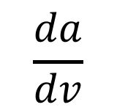
Computation Graphs and Derivatives
$$\frac{da}{dv}$$
b=1
+
v = u+b
a = relu(v)
x
*
u = wx
w=2
Calculus refresher:
https://sebastianraschka.com/pdf/books/dlb/appendix_d_calculus.pdf

Slide 21
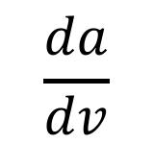
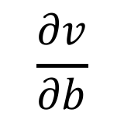
$$\frac{∂v}{∂b}$$
$$\frac{da}{dv}$$
b=1
+
v = u+b
a = relu(v)
x
*
u = wx
w=2
Calculus refresher:
https://sebastianraschka.com/pdf/books/dlb/appendix_d_calculus.pdf

Slide 22
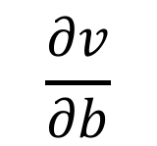
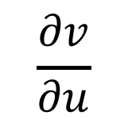
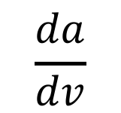
$$\frac{∂v}{∂b}$$
$$\frac{da}{dv}$$
b=1
+
v = u+b
a = relu(v)
x
*
u = wx
w=2
$$\frac{∂v}{∂u}$$

Slide 23
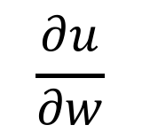
$$\frac{∂v}{∂b}$$
$$\frac{da}{dv}$$
b=1
+
v = u+b
a = relu(v)
x
*
u = wx
w=2
$$\frac{∂v}{∂u}$$
$$\frac{∂u}{∂w}$$

Slide 24
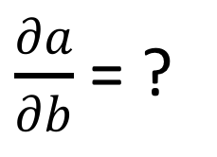
$$\frac{∂v}{∂b}$$
$\frac{∂a}{∂b}$ = ?
$$\frac{da}{dv}$$
b=1
+
v = u+b
a = relu(v)
x
*
u = wx
w=2
$$\frac{∂v}{∂u}$$
$$\frac{∂u}{∂w}$$

Slide 25
Chain Rule

Slide 26
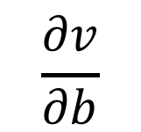
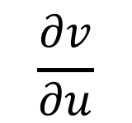
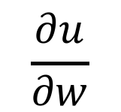
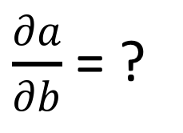
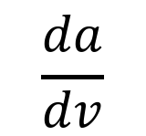
$\frac{∂a}{∂b}$ = ?
$$\frac{∂v}{∂b}$$
$$\frac{da}{dv}$$
b=1
+
v = u+b
a = relu(v)
x
*
u = wx
w=2
$$\frac{∂v}{∂u}$$
$$\frac{∂u}{∂w}$$

Slide 27
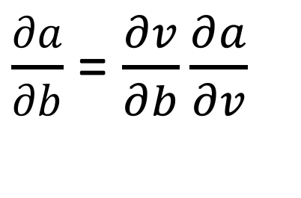
$\frac{∂a}{∂b}$ = $\frac{∂v}{∂b}\frac{∂a}{∂v}$
$$\frac{∂v}{∂b}$$
$$\frac{da}{dv}$$
b=1
+
v = u+b
a = relu(v)
x
*
u = wx
w=2
$$\frac{∂v}{∂u}$$
$$\frac{∂u}{∂w}$$

Slide 28
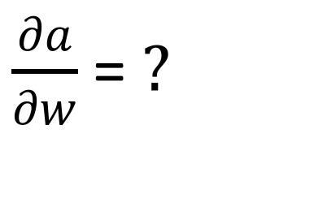
$\frac{∂a}{∂b}$ = $\frac{∂v}{∂b}\frac{∂a}{∂v}$
$$\frac{∂v}{∂b}$$
$$\frac{da}{dv}$$
b=1
+
v = u+b
a = relu(v)
x
*
u = wx
w=2
$$\frac{∂v}{∂u}$$
$$\frac{∂u}{∂w}$$
$\frac{∂a}{∂w}$ = $?$

Slide 29
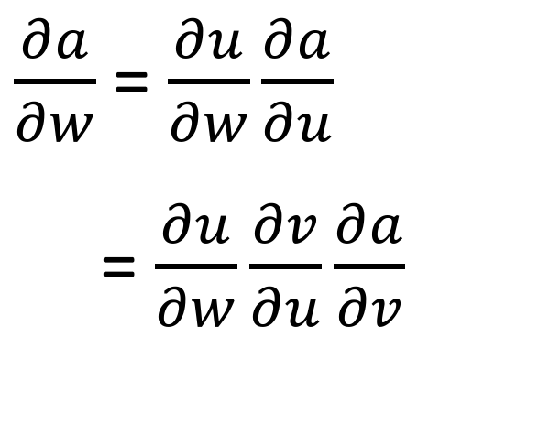
$\frac{∂a}{∂b}$ = $\frac{∂v}{∂b}\frac{∂a}{∂v}$
$$\frac{∂v}{∂b}$$
$$\frac{da}{dv}$$
b=1
+
v = u+b
a = relu(v)
x
*
u = wx
w=2
$\frac{∂a}{∂w}$ = $\frac{∂u}{∂w}\frac{∂a}{∂u}$
= $\frac{∂u}{∂w}\frac{∂v}{∂u}\frac{∂a}{∂v}$
$$\frac{∂v}{∂u}$$
$$\frac{∂u}{∂w}$$

Slide 30
b=1
+
v = u+b
a = relu(v)
3.0
x
*
u = wx
w=2

Slide 31
$\frac{∂a}{∂b}$ = $\frac{∂v}{∂b}\frac{∂a}{∂v}$
$$\frac{∂v}{∂b}$$
$$\frac{da}{dv}$$
b=1
7
7
6
+
v = u+b
a = relu(v)
x=3
*
u = wx
w=2
$\frac{∂a}{∂w}$ = $\frac{∂u}{∂w}\frac{∂a}{∂u}$
= $\frac{∂u}{∂w}\frac{∂v}{∂u}\frac{∂a}{∂v}$
$$\frac{∂v}{∂u}$$
$$\frac{∂u}{∂w}$$

Slide 32
$\frac{∂a}{∂b}$ = $\frac{∂v}{∂b}\frac{∂a}{∂v}$
$$\frac{∂v}{∂b}$$
$$\frac{da}{dv}$$
= ?
b=1
7
7
6
+
v = u+b
a = relu(v)
x=3
*
u = wx
w=2
$\frac{∂a}{∂w}$ = $\frac{∂u}{∂w}\frac{∂a}{∂u}$
= $\frac{∂u}{∂w}\frac{∂v}{∂u}\frac{∂a}{∂v}$
$$\frac{∂v}{∂u}$$
$$\frac{∂u}{∂w}$$

Slide 33
$\frac{∂a}{∂b}$ = $\frac{∂v}{∂b}\frac{∂a}{∂v}$
$$\frac{∂v}{∂b}$$
= ?
$$\frac{da}{dv}$$
= 1
b=1
7
7
6
+
v = u+b
a = relu(v)
x=3
*
u = wx
w=2
$\frac{∂a}{∂w}$ = $\frac{∂u}{∂w}\frac{∂a}{∂u}$
= $\frac{∂u}{∂w}\frac{∂v}{∂u}\frac{∂a}{∂v}$
$$\frac{∂v}{∂u}$$
= ?
$$\frac{∂u}{∂w}$$

Slide 34
$\frac{∂a}{∂b}$ = $\frac{∂v}{∂b}\frac{∂a}{∂v}$
$$\frac{∂v}{∂b}$$
= 0 + 1 = 1
$$\frac{da}{dv}$$
= 1
b=1
7
7
6
+
v = u+b
a = relu(v)
x=3
*
u = wx
w=2
$\frac{∂a}{∂w}$ = $\frac{∂u}{∂w}\frac{∂a}{∂u}$
= $\frac{∂u}{∂w}\frac{∂v}{∂u}\frac{∂a}{∂v}$
$$\frac{∂v}{∂u}$$
= 1 + 0 = 1
$$\frac{∂u}{∂w}$$

Slide 35
$\frac{∂a}{∂b}$ = $\frac{∂v}{∂b}\frac{∂a}{∂v}$
$$\frac{∂v}{∂b}$$
= 1
$$\frac{da}{dv}$$
= 1
b=1
7
7
6
+
v = u+b
a = relu(v)
x=3
*
u = wx
w=2
$\frac{∂a}{∂w}$ = $\frac{∂u}{∂w}\frac{∂a}{∂u}$
= $\frac{∂u}{∂w}\frac{∂v}{∂u}\frac{∂a}{∂v}$
$$\frac{∂v}{∂u}$$
= 1
$$\frac{∂u}{∂w}$$
= ?

Slide 36
$\frac{∂a}{∂b}$ = $\frac{∂v}{∂b}\frac{∂a}{∂v}$
$$\frac{∂v}{∂b}$$
= 1
$$\frac{da}{dv}$$
= 1
b=1
7
7
6
+
v = u+b
a = relu(v)
x=3
*
u = wx
w=2
$\frac{∂a}{∂w}$ = $\frac{∂u}{∂w}\frac{∂a}{∂u}$
= $\frac{∂u}{∂w}\frac{∂v}{∂u}\frac{∂a}{∂v}$
$$\frac{∂v}{∂u}$$
= 1
$$\frac{∂u}{∂w}$$
= x = 3

Slide 37
$\frac{∂a}{∂b}$ = $\frac{∂v}{∂b}\frac{∂a}{∂v}$
= ?
$$\frac{∂v}{∂b}$$
= 1
$$\frac{da}{dv}$$
= 1
b=1
7
7
6
+
v = u+b
a = relu(v)
x=3
*
u = wx
w=2
$\frac{∂a}{∂w}$ = $\frac{∂u}{∂w}\frac{∂a}{∂u}$
= $\frac{∂u}{∂w}\frac{∂v}{∂u}\frac{∂a}{∂v}$
$$\frac{∂v}{∂u}$$
= 1
$$\frac{∂u}{∂w}$$
= 3

Slide 38
$\frac{∂a}{∂b}$ = $\frac{∂v}{∂b}\frac{∂a}{∂v}$
= 1*1 = 1
$$\frac{∂v}{∂b}$$
= 1
$$\frac{da}{dv}$$
= 1
b=1
7
7
6
+
v = u+b
a = relu(v)
x=3
*
u = wx
w=2
$\frac{∂a}{∂w}$ = $\frac{∂u}{∂w}\frac{∂a}{∂u}$
= $\frac{∂u}{∂w}\frac{∂v}{∂u}\frac{∂a}{∂v}$
$$\frac{∂v}{∂u}$$
= 1
$$\frac{∂u}{∂w}$$
= 3

Slide 39
$\frac{∂a}{∂b}$ = $\frac{∂v}{∂b}\frac{∂a}{∂v}$
= 1
$$\frac{∂v}{∂b}$$
= 1
$$\frac{da}{dv}$$
= 1
b=1
7
7
6
+
v = u+b
a = relu(v)
x=3
*
u = wx
w=2
$\frac{∂a}{∂w}$ = $\frac{∂u}{∂w}\frac{∂a}{∂u}$
= $\frac{∂u}{∂w}\frac{∂v}{∂u}\frac{∂a}{∂v}$
$$\frac{∂v}{∂u}$$
= 1
$$\frac{∂u}{∂w}$$
= 3
= ?

Slide 40
$\frac{∂a}{∂b}$ = $\frac{∂v}{∂b}\frac{∂a}{∂v}$
= 1
$$\frac{∂v}{∂b}$$
= 1
$$\frac{da}{dv}$$
= 1
b=1
7
7
6
+
v = u+b
a = relu(v)
x=3
*
u = wx
w=2
$\frac{∂a}{∂w}$ = $\frac{∂u}{∂w}\frac{∂a}{∂u}$
= $\frac{∂u}{∂w}\frac{∂v}{∂u}\frac{∂a}{∂v}$
$$\frac{∂v}{∂u}$$
= 1
$$\frac{∂u}{∂w}$$
= 3
= 3*1*1 = 3

Slide 42
with g.as_default() as g:
d_a_w = tf.gradients(a, w)
d_b_w = tf.gradients(a, b)
with tf.Session(graph=g) as sess:
sess.run(init_op)
dw, db = sess.run([d_a_w, d_b_w], feed_dict={'x:0': 3})
print(dw, db)
[3.0] [1.0]

Slide 43
g = tf.Graph()
with g.as_default() as g:
x = tf.placeholder(dtype=tf.float32, shape=None, name='x')
w = tf.Variable(initial_value=2, dtype=tf.float32, name='w')
b = tf.Variable(initial_value=1, dtype=tf.float32, name='b')
u = x * w
v = u + b
a = tf.nn.relu(v)
d_a_w = tf.gradients(a, w)
d_b_w = tf.gradients(a, b)
with tf.Session(graph=g) as sess:
sess.run(tf.global_variables_initializer())
res = sess.run([d_a_w, d_b_w], feed_dict={'x:0': 3})

Slide 44
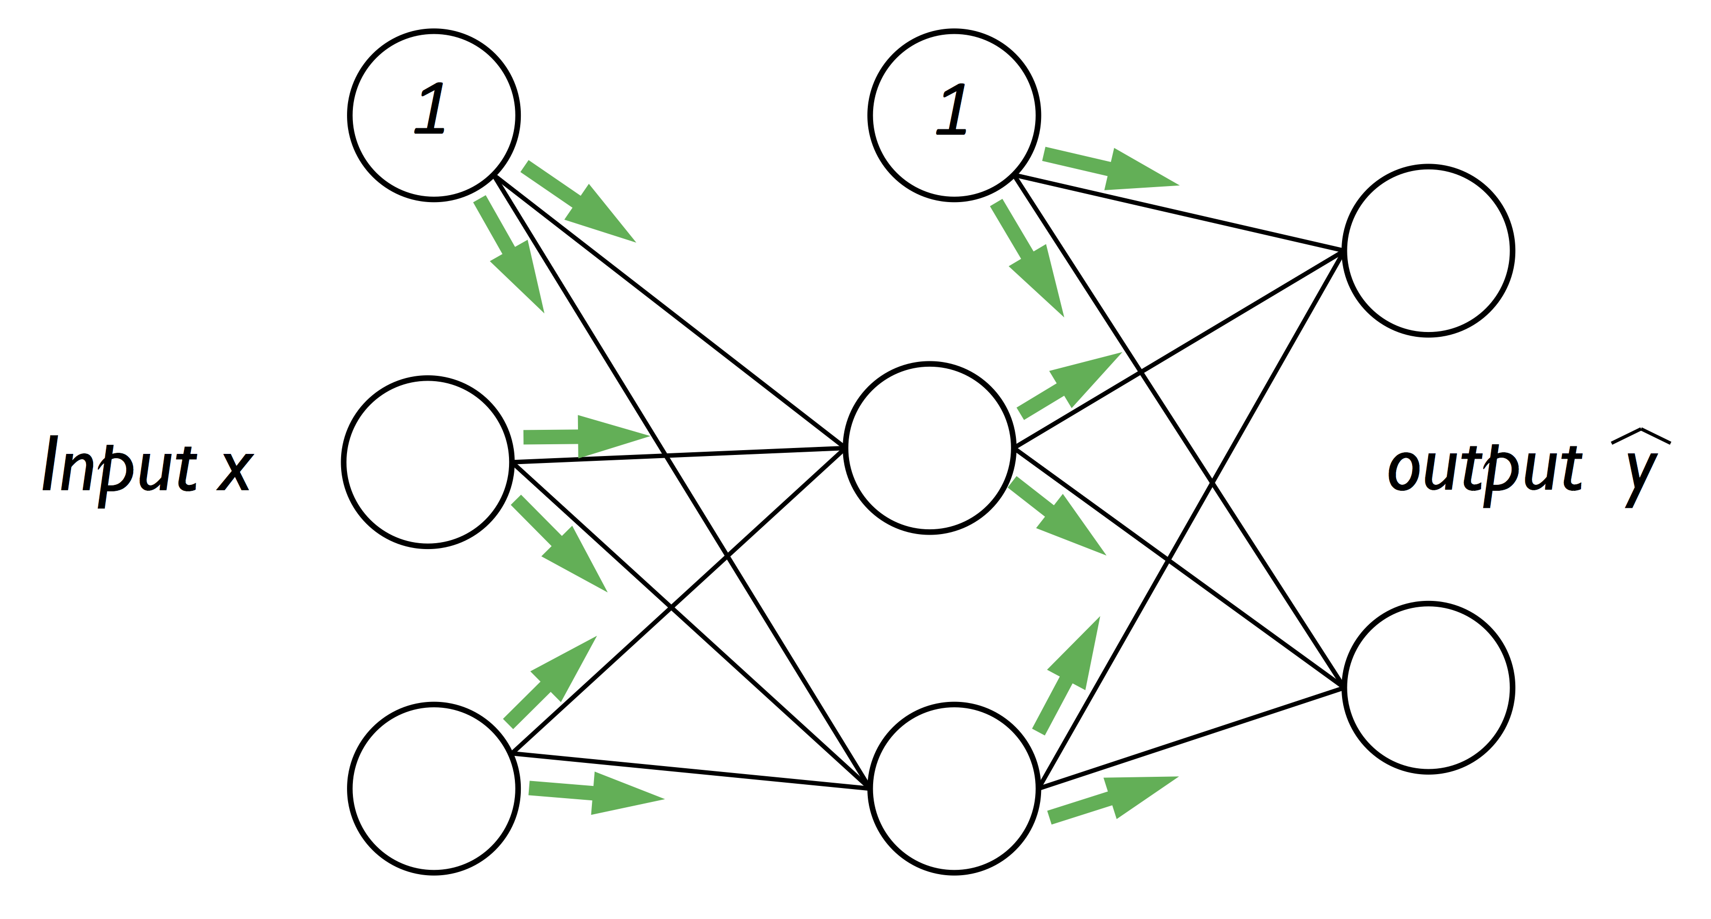
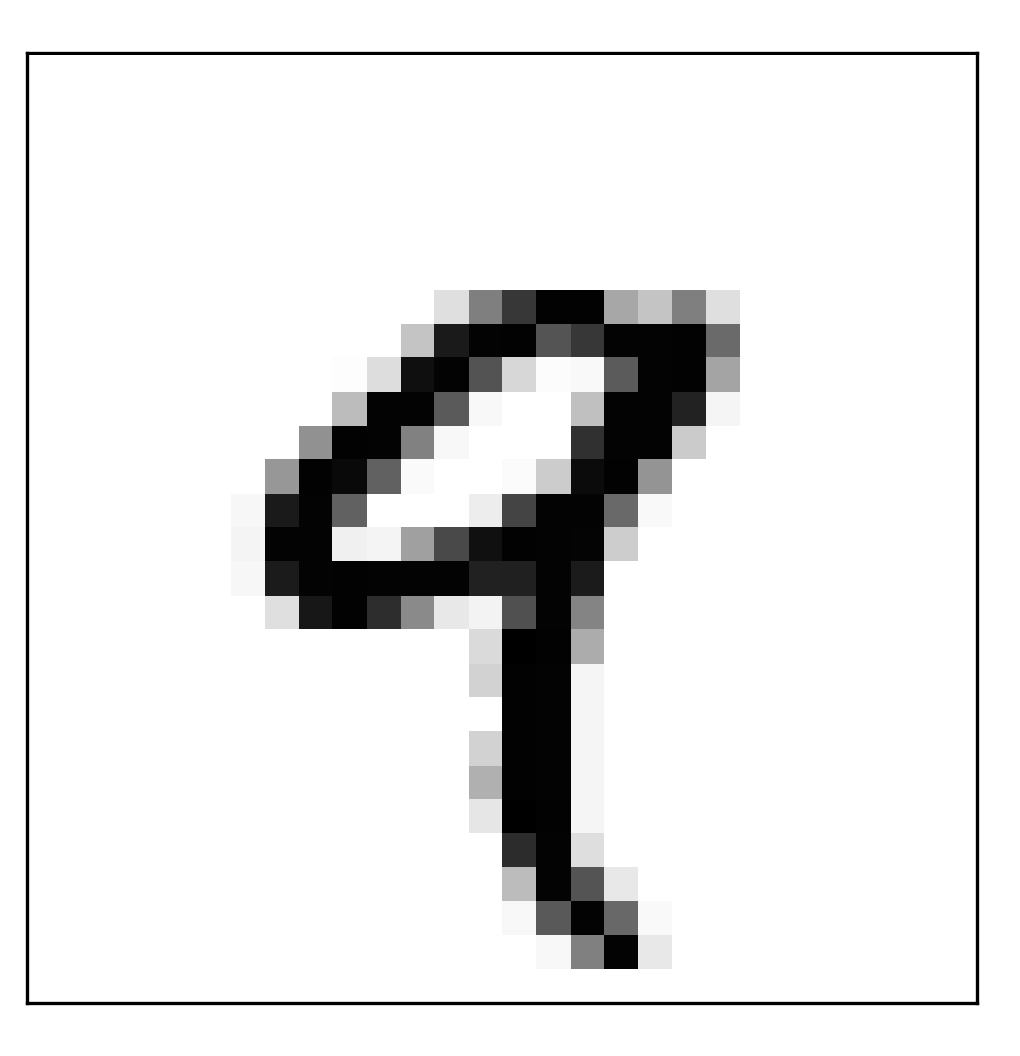
Multilayer Perceptron – Forward Pass
reshape

Slide 45
reshape

Slide 46
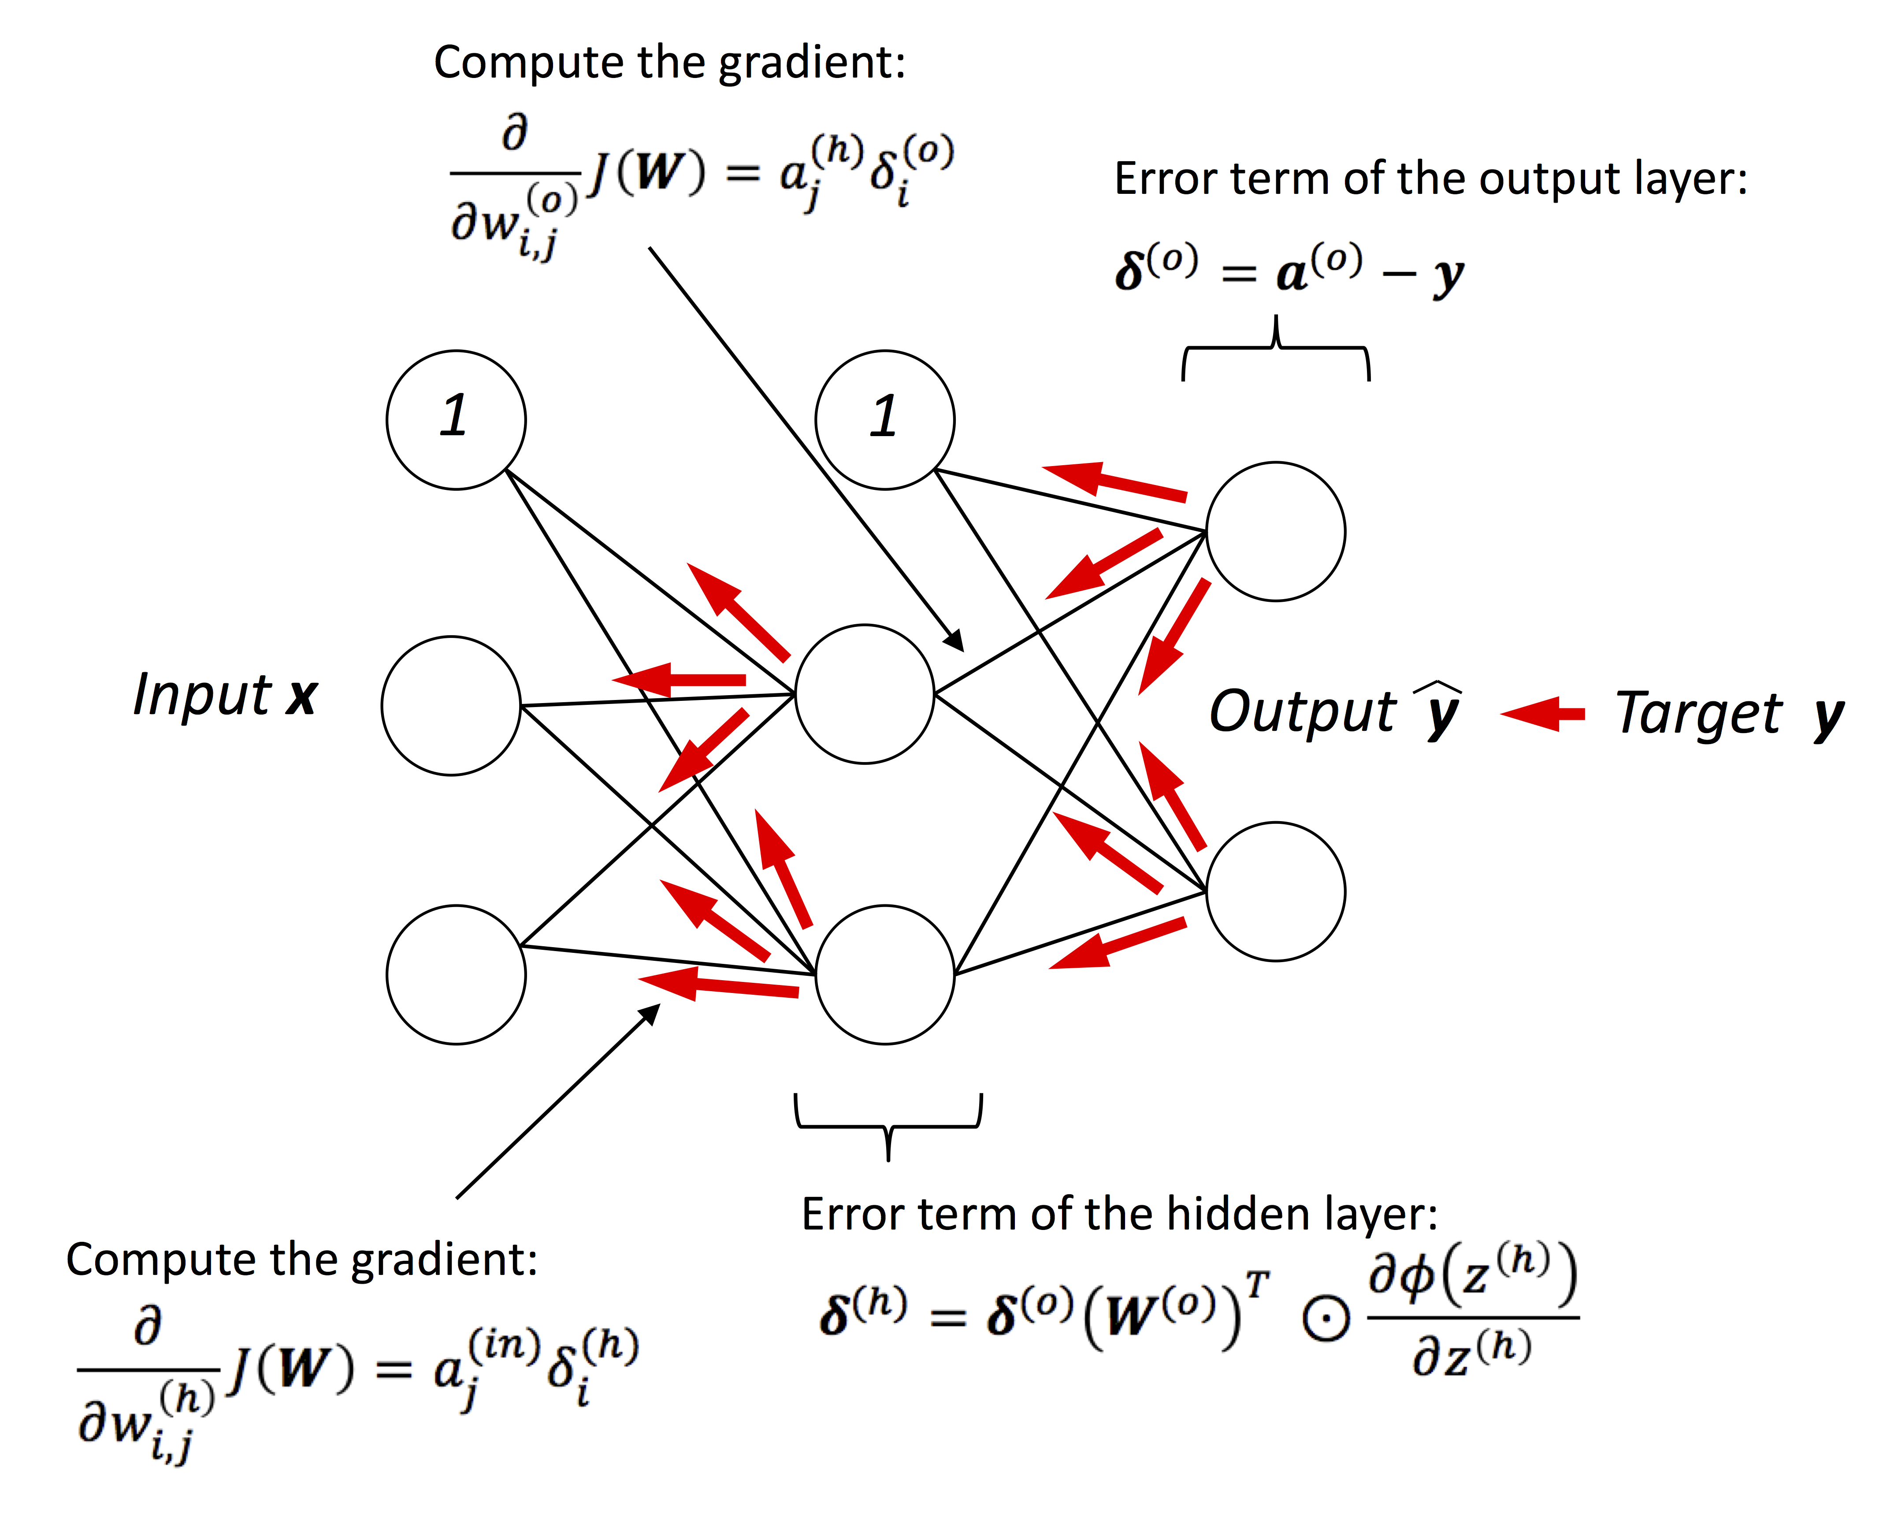
Multilayer Perceptron – Backpropagation
As implemented in https://github.com/rasbt/pydata-annarbor2017-dl-tutorial/blob/master/code.ipynb

Slide 47
TensorFlow makes implementing neural nets very convenient!

Slide 48
# Loss
loss = tf.nn.softmax_cross_entropy_with_logits(logits=out_z, labels=tf_y)
cost = tf.reduce_mean(loss, name='cost')
# input/output dim: [n_samples, n_classlabels]
sigma_out = (out_act - tf_y) / batch_size
# input/output dim: [n_samples, n_hidden_1]
softmax_derivative_h1 = h1_act * (1. - h1_act)
# input dim: [n_samples, n_classlabels] dot [n_classlabels, n_hidden]
# output dim: [n_samples, n_hidden]
sigma_h = (tf.matmul(sigma_out, tf.transpose(weights['out'])) *
softmax_derivative_h1)
# input dim: [n_features, n_samples] dot [n_samples, n_hidden]
# output dim: [n_features, n_hidden]
grad_w_h1 = tf.matmul(tf.transpose(tf_x), sigma_h)
grad_b_h1 = tf.reduce_sum(sigma_h, axis=0)
# input dim: [n_hidden, n_samples] dot [n_samples, n_classlabels]
# output dim: [n_hidden, n_classlabels]
grad_w_out = tf.matmul(tf.transpose(h1_act), sigma_out)
grad_b_out = tf.reduce_sum(sigma_out, axis=0)
# Update weights
upd_w_1 = tf.assign(weights['h1'], weights['h1'] - learning_rate * grad_w_h1)
upd_b_1 = tf.assign(biases['b1'], biases['b1'] - learning_rate * grad_b_h1)
upd_w_out = tf.assign(weights['out'], weights['out'] - learning_rate * grad_w_out)
upd_b_out = tf.assign(biases['out'], biases['out'] - learning_rate * grad_b_out)
train = tf.group(upd_w_1, upd_b_1, upd_w_out, upd_b_out, name='train')
(very)
low-level
backprop

Slide 49
##########################
### TRAINING & EVALUATION
##########################
with tf.Session(graph=g) as sess:
sess.run(tf.global_variables_initializer())
for epoch in range(training_epochs):
avg_cost = 0.
total_batch = mnist.train.num_examples // batch_size
for i in range(total_batch):
batch_x, batch_y = mnist.train.next_batch(batch_size)
_, c = sess.run(['train', 'cost:0'], feed_dict={'features:0': batch_x,
'targets:0': batch_y})

Slide 50
low-level backprop
# Loss
loss = tf.nn.softmax_cross_entropy_with_logits(logits=out_z, labels=tf_y)
cost = tf.reduce_mean(loss, name='cost')
##################
# Backpropagation
##################
# Get Gradients
dc_dw_out, dc_db_out = tf.gradients(cost, [weights['out'], biases['out']])
dc_dw_1, dc_db_1 = tf.gradients(cost, [weights['h1'], biases['b1']])
# Update Weights
upd_w_1 = tf.assign(weights['h1'], weights['h1'] - learning_rate * dc_dw_1)
upd_b_1 = tf.assign(biases['b1'], biases['b1'] - learning_rate * dc_db_1)
upd_w_out = tf.assign(weights['out'], weights['out'] - learning_rate * dc_dw_out)
upd_b_out = tf.assign(biases['out'], biases['out'] - learning_rate * dc_db_out)
train = tf.group(upd_w_1, upd_b_1, upd_w_out, upd_b_out, name='train')

Slide 51
“convenient” backprop
# Loss
loss = tf.nn.softmax_cross_entropy_with_logits(logits=out_z, labels=tf_y)
cost = tf.reduce_mean(loss, name='cost')
##################
# Backpropagation
##################
optimizer = tf.train.GradientDescentOptimizer(learning_rate=learning_rate)
train = optimizer.minimize(cost, name='train')

Slide 52
##########################
### TRAINING & EVALUATION
##########################
with tf.Session(graph=g) as sess:
sess.run(tf.global_variables_initializer())
for epoch in range(training_epochs):
avg_cost = 0.
total_batch = mnist.train.num_examples // batch_size
for i in range(total_batch):
batch_x, batch_y = mnist.train.next_batch(batch_size)
_, c = sess.run(['train', 'cost:0'], feed_dict={'features:0': batch_x,
'targets:0': batch_y})

Slide 53

TensorFlow Layers

Slide 54
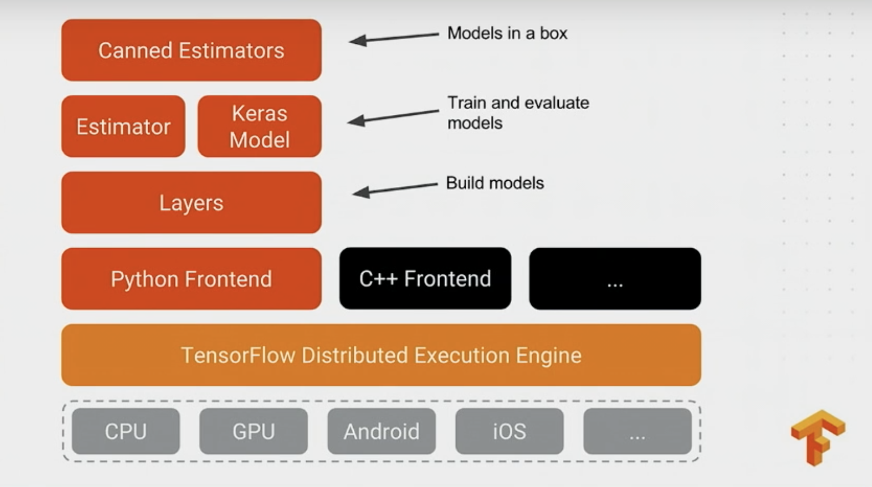

Link to the talk: https://www.youtube.com/watch?v=t64ortpgS-E
Estimator Documentation: https://www.tensorflow.org/extend/estimators

Slide 55
Defining your wrapper functions manually
def fully_connected(input_tensor, output_nodes,
activation=None, seed=None,
name='fully_connected'):
with tf.variable_scope(name):
input_nodes = input_tensor.get_shape().as_list()[1]
weights = tf.Variable(tf.truncated_normal(shape=(input_nodes,
output_nodes),
mean=0.0,
stddev=0.01,
dtype=tf.float32,
seed=seed),
name='weights')
biases = tf.Variable(tf.zeros(shape=[output_nodes]), name='biases')
act = tf.matmul(input_tensor, weights) + biases
if activation is not None:
act = activation(act)
return act

Slide 56
Using tensorflow.layers
g = tf.Graph()
with g.as_default():
# Input data
tf_x = tf.placeholder(tf.float32, [None, n_input], name='features')
tf_y = tf.placeholder(tf.float32, [None, n_classes], name='targets')
# Multilayer perceptron
layer_1 = tf.layers.dense(tf_x, n_hidden_1,
activation=tf.nn.relu,
kernel_initializer=tf.truncated_normal_initializer(stddev=0.1))
layer_2 = tf.layers.dense(layer_1, n_hidden_2,
activation=tf.nn.relu,
kernel_initializer=tf.truncated_normal_initializer(stddev=0.1))
out_layer = tf.layers.dense(layer_2, n_classes, activation=None)

Slide 57
Feeding Data into the Graph
From Python via placeholders
Python pickle
NumPy .npz archives (https://github.com/rasbt/deep-learning-book/blob/master/code/model_zoo/image-data-chunking-npz.ipynb)
HDF5 (https://github.com/rasbt/deep-learning-book/blob/master/code/model_zoo/image-data-chunking-hdf5.ipynb)
CSV
…
sess.run([…], feed_dict={'x:0': …, 'y:0': …, …})
Using input pipelines and queues
- Reading data from TFRecords files (https://github.com/rasbt/deep-learning-book/blob/master/code/model_zoo/tfrecords.ipynb)
- Queues for loading raw images (https://github.com/rasbt/deep-learning-book/blob/master/code/model_zoo/file-queues.ipynb)
More info: https://www.tensorflow.org/programmers_guide/reading_data

Slide 58
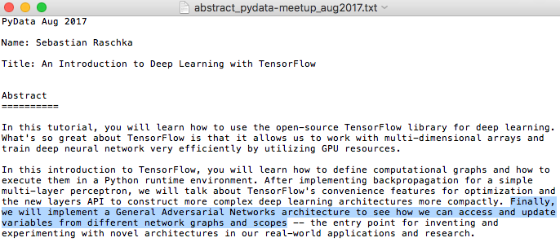

Slide 59
Code snippets
GitHub: https://github.com/rasbt/pydata-annarbor2017-dl-tutorial

Slide 60
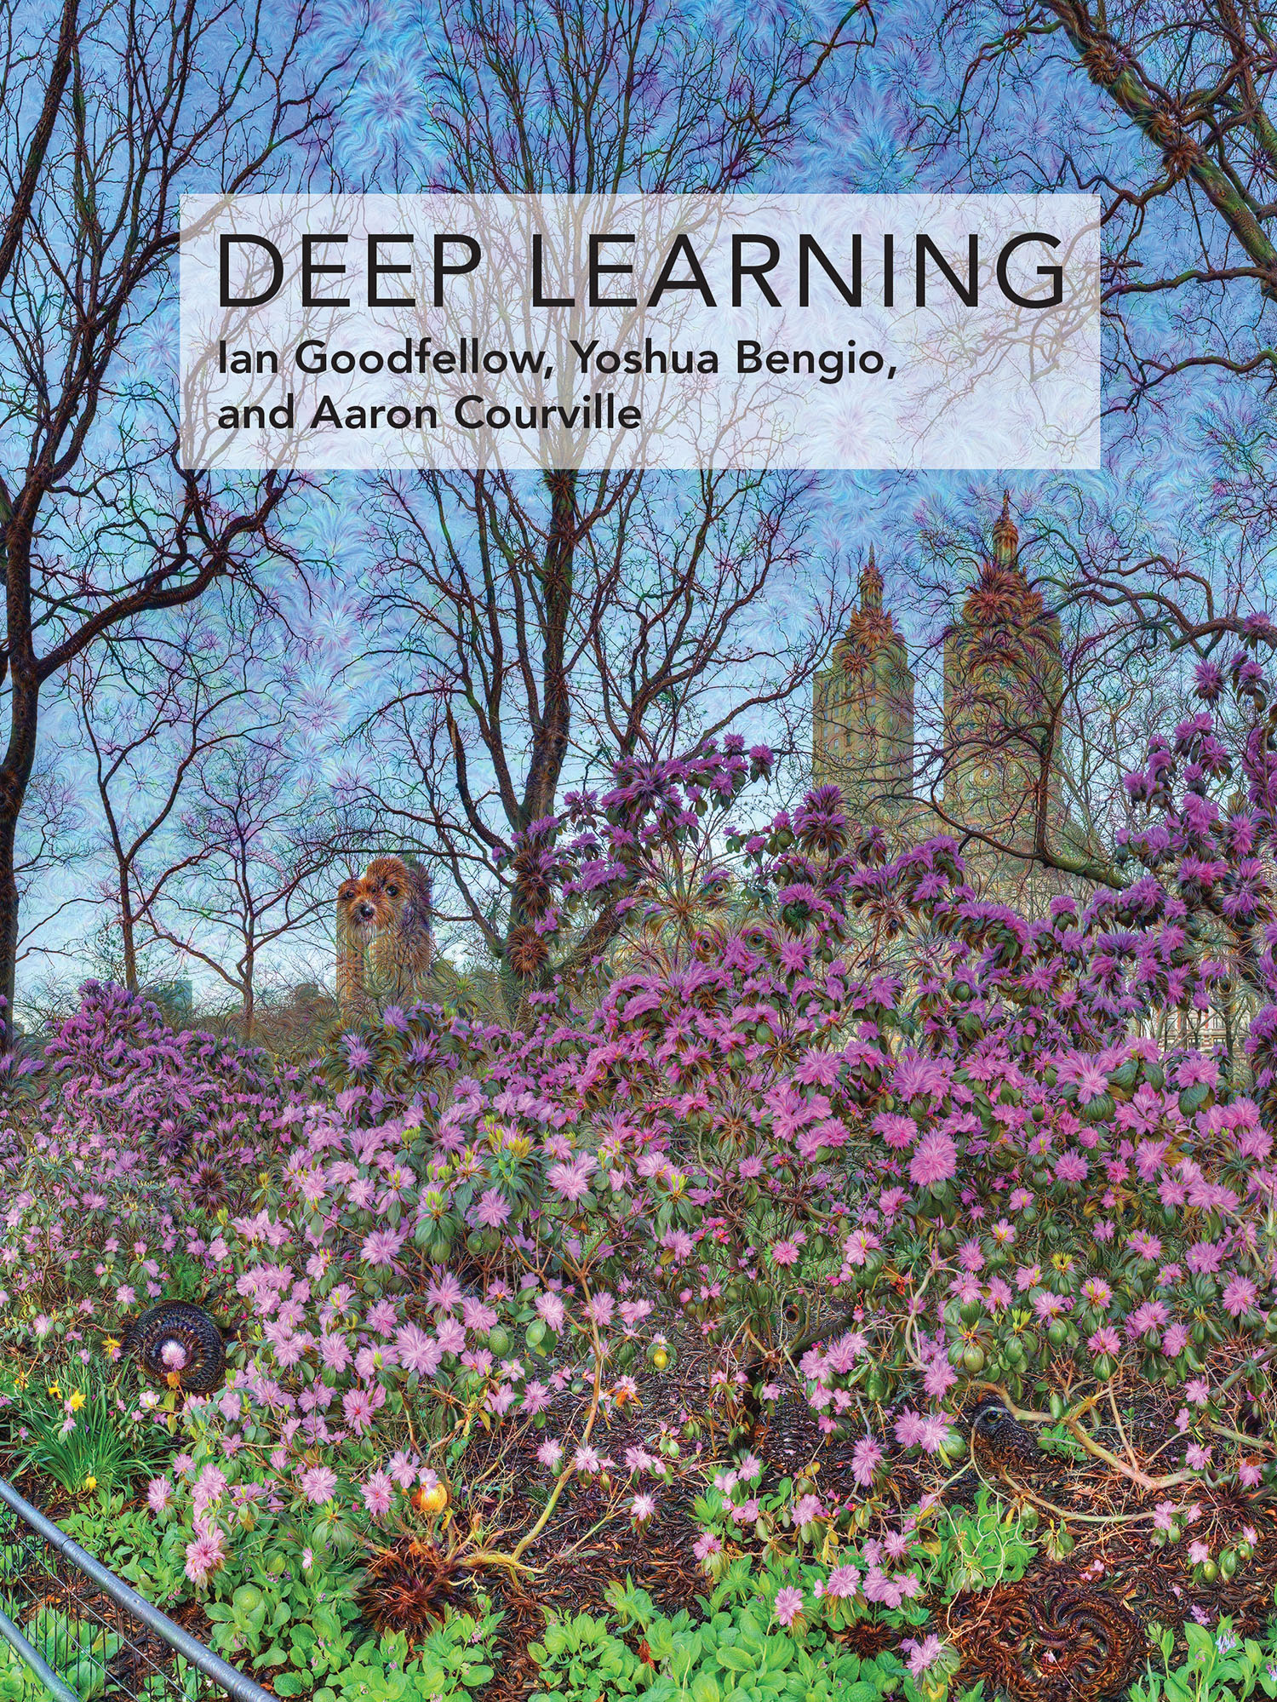
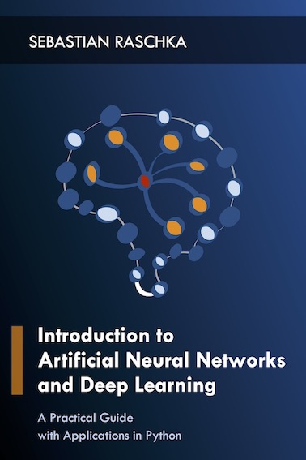

Useful (and Free) Resources
http://www.deeplearningbook.org
https://github.com/rasbt/deep-learning-book
https://www.tensorflow.org

Slide 61
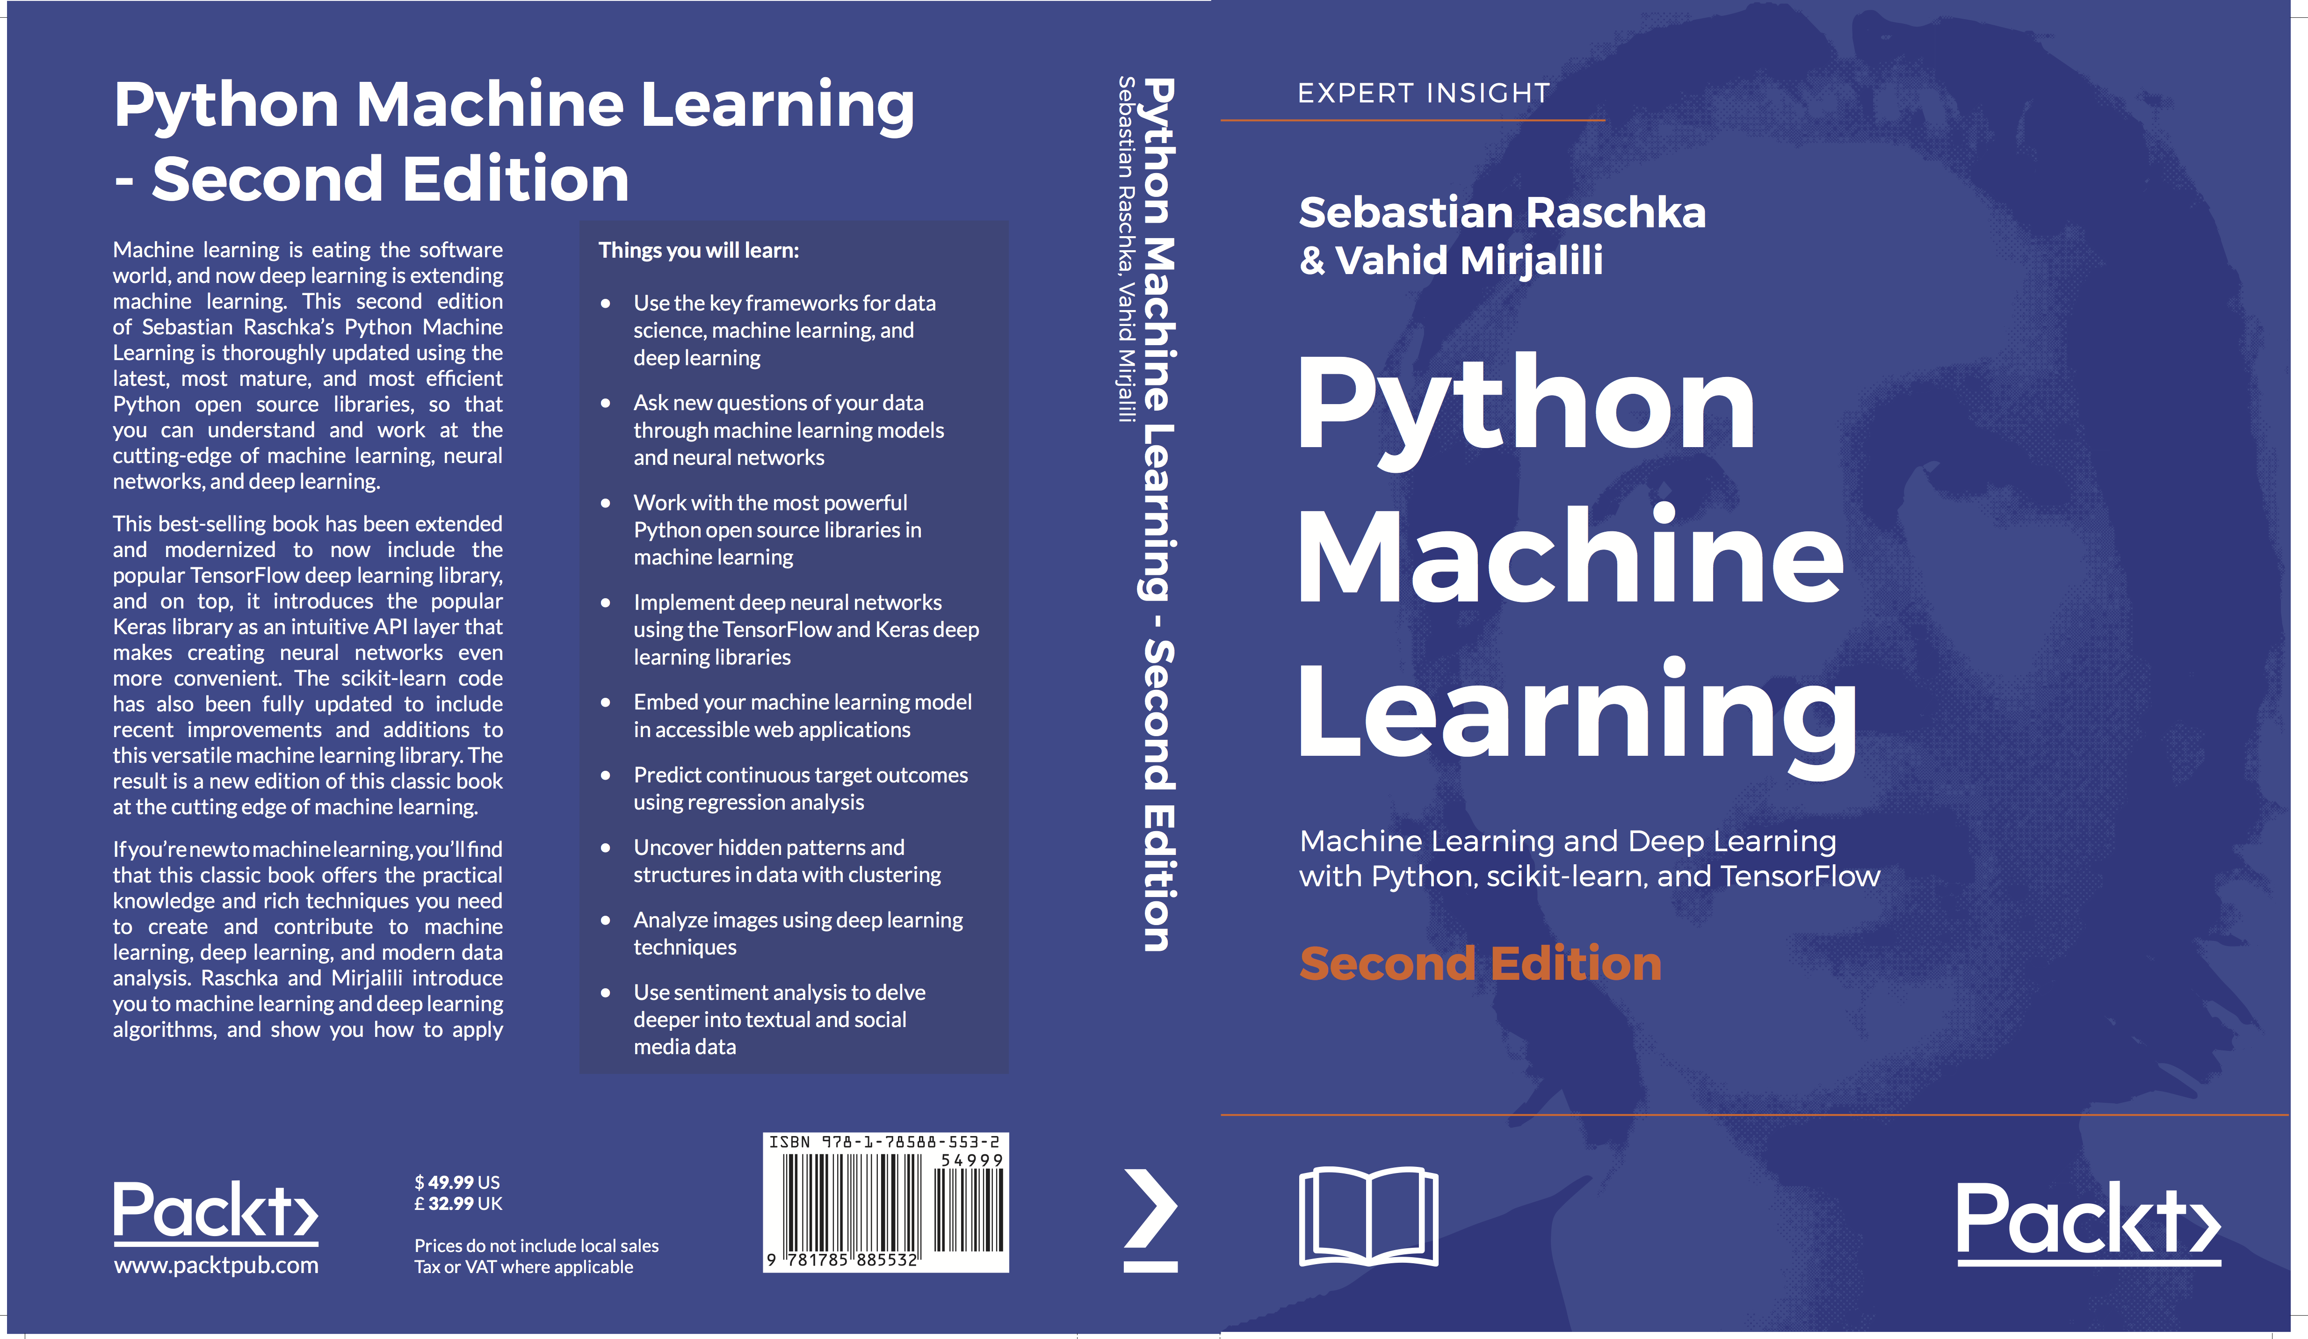
One More Thing!
https://www.amazon.com/Python-Machine-Learning-scikit-learn-TensorFlow/dp/1787125939/

Slide 62
Thanks for attending!
Slides
Speaker Deck:
https://speakerdeck.com/rasbt/introduction-to-deep-learning-with-tensorflow-at-pydata-ann-arbor
Code snippets
GitHub:
https://github.com/rasbt/pydata-annarbor2017-dl-tutorial
Contact:
E-mail: mail@sebastianraschka.com
Website: http://sebastianraschka.com
Twitter: @rasbt
GitHub: rasbt

Slide 63
Thanks for attending!
Questions?
Slides
Speaker Deck:
https://speakerdeck.com/rasbt/introduction-to-deep-learning-with-tensorflow-at-pydata-ann-arbor
Code snippets
GitHub:
https://github.com/rasbt/pydata-annarbor2017-dl-tutorial
Contact:
E-mail: mail@sebastianraschka.com
Website: http://sebastianraschka.com
Twitter: @rasbt
GitHub: rasbt

